Slide 1
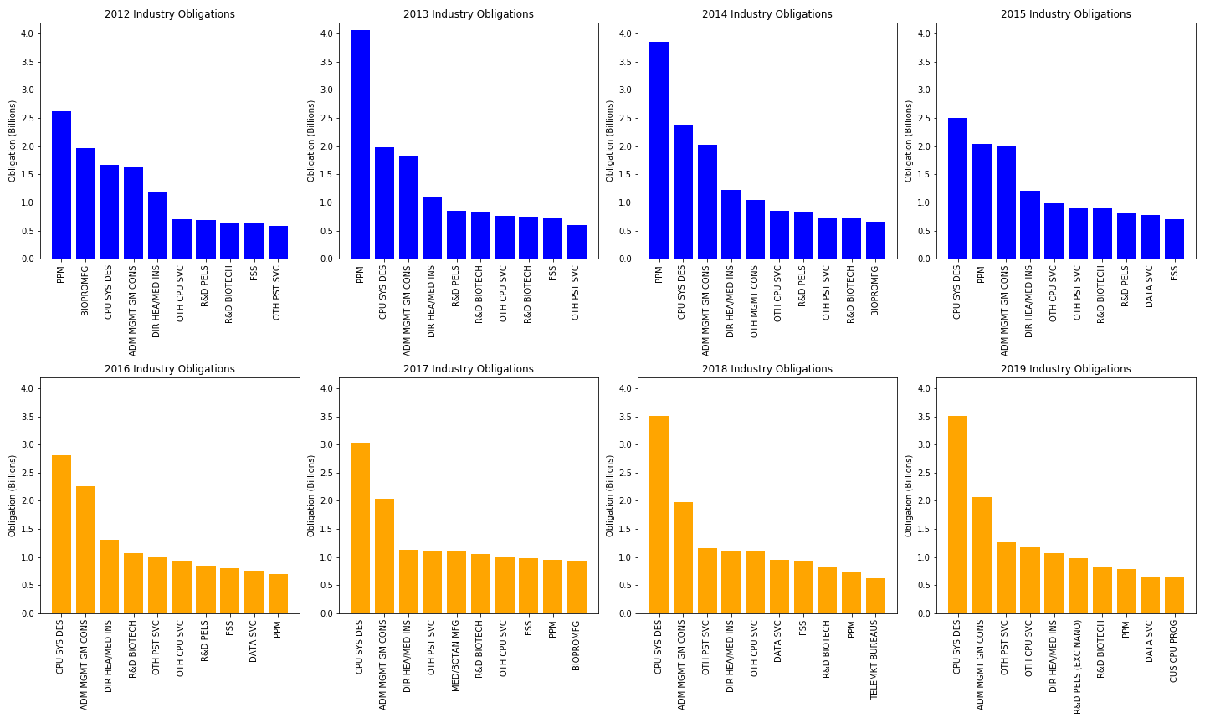
TOP 10 INDUSTRIES 2012-2019
Conclusion: Top 10 industries seem to simply be following technology trends in a rapidly growing healthcare market expanding use of data; would need a larger study to verify
Most Frequent Top 3 Industries:
Pharmaceuticals (PPM)
Cost’s ~2.5 billion to bring a single drug to market
CPU Systems Design Services (CPU SYS DES)
Administrative Management and General Management Consulting (ADM MGMT GM CONS)
Various R&D industry categories tend to remain but fluctuate in the top 10

Slide 2
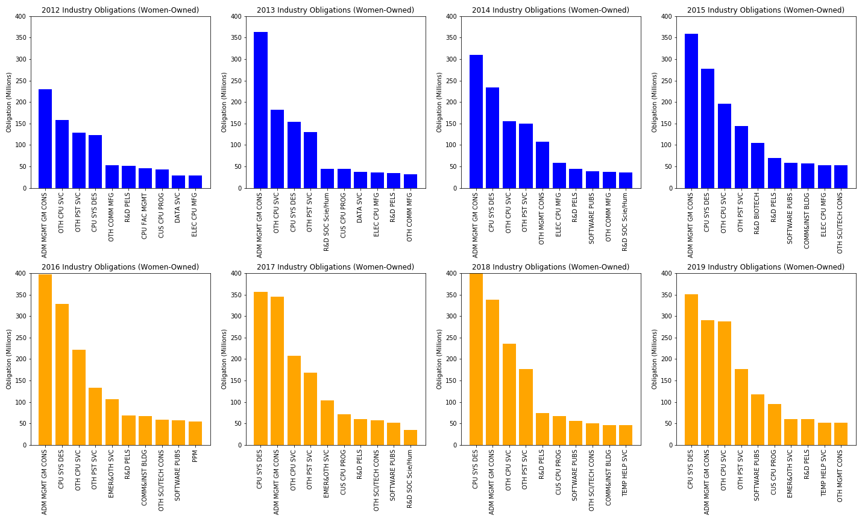
TOP 10 INDUSTRIES (Women-Owned) 2012-2019
Conclusion: Top 10 industries for women owned business are largely administrative services based and Information Technology based; trend follows suit with overall industry top 10
Where things differ:
Pharmaceuticals (PPM)
Only 1 instance of women-owned top 10 (2016)
0.34% of $15B
CPU Systems Design Services (CPU SYS DES)
2012: 7.34%
2019: 10.02%
$228m difference
Administrative Management and General Management Consulting (ADM MGMT GM CONS)
2012: 14.14%
2019: 14.06%

